Slide 1
ParkEZ Application
Team 2 :
Tom Cookson
Tom Alex
Shubham Mittal
Chetan Besnat
Krunal Bhavsar
Suruchi Patil
Srija Reddy
Ruchi Sharma
Swayambhu Dhuri

Slide 2
TABLE OF CONTENTS
01
02
03
04
GitHub URL
Repository Structure
Build & Deployment Procedures
Source Code Excerpt

Slide 3
GitHub URL
https://github.com/swayambhu/parkEz

Slide 4
02
Repository Structure

Slide 5
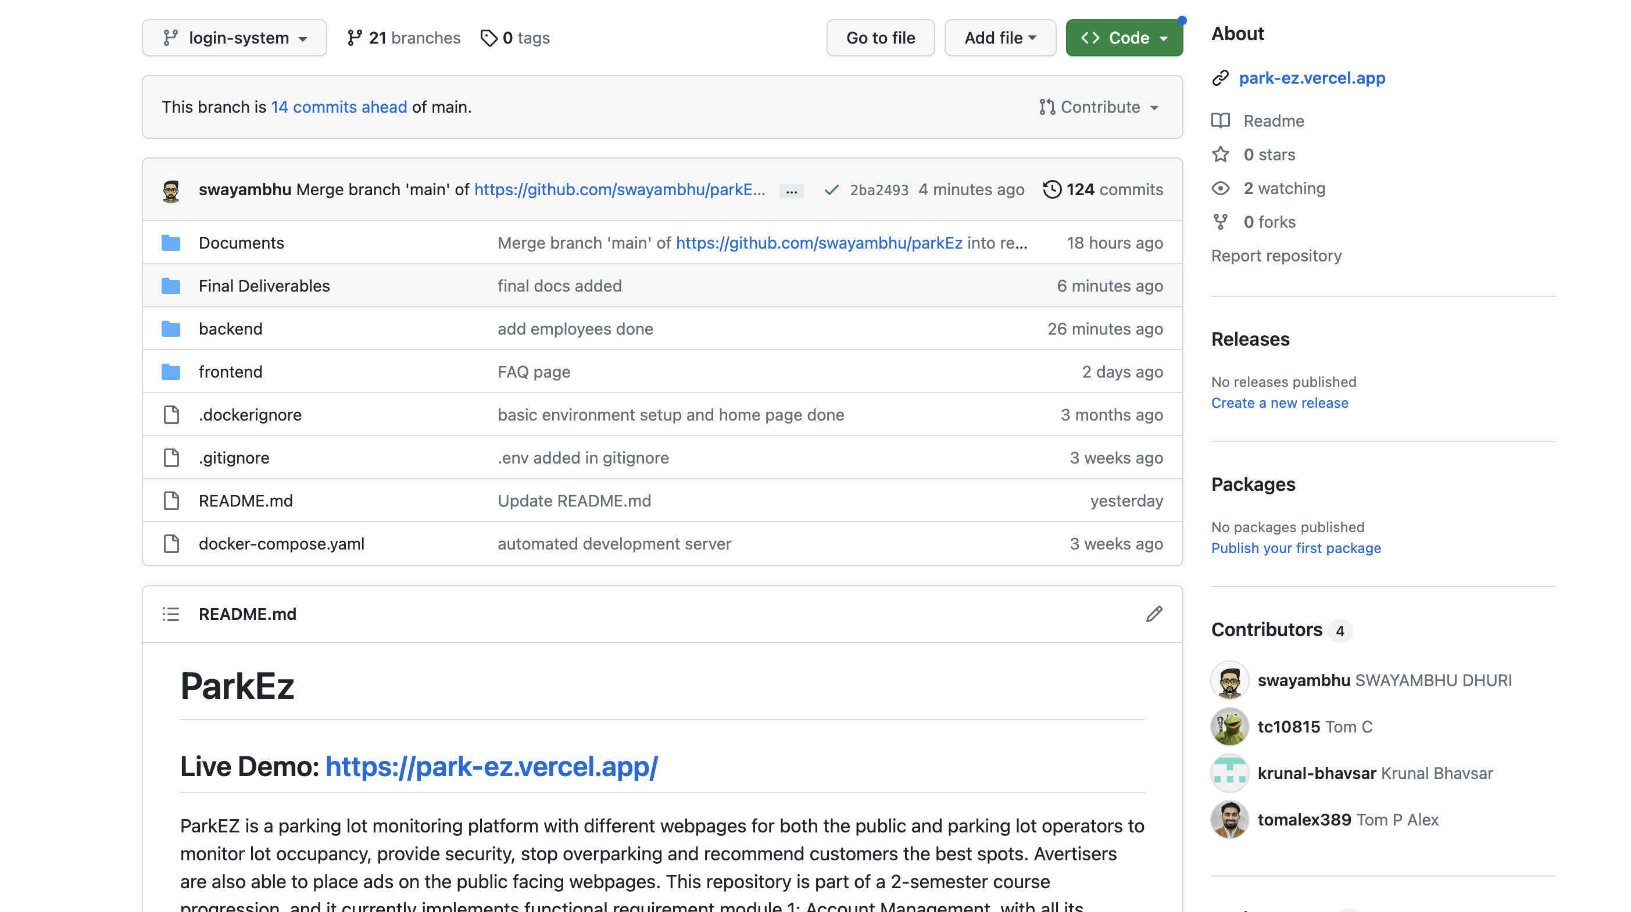

Slide 6
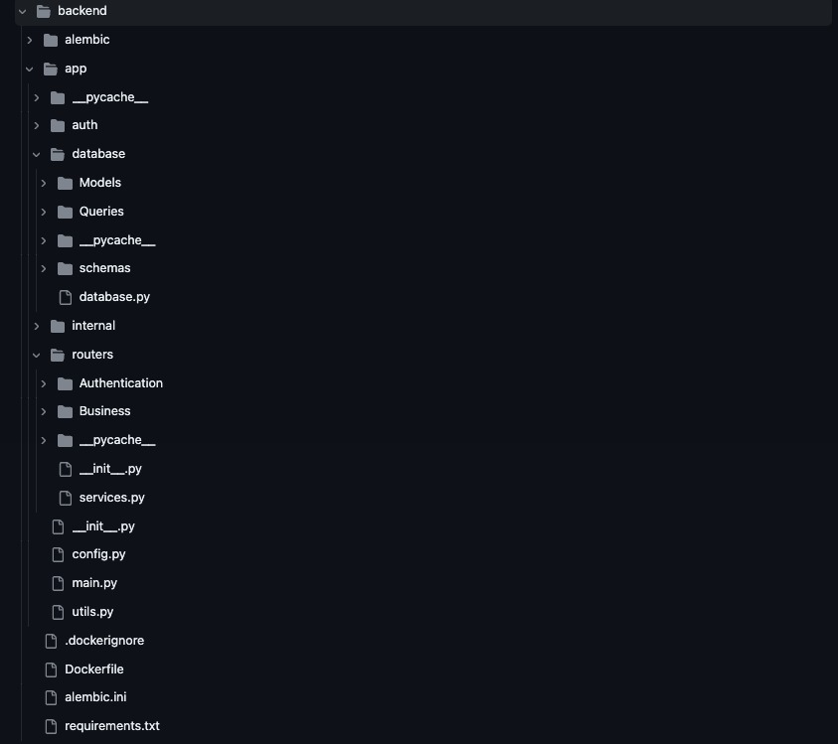
Repository Structure (Backend)

Slide 7
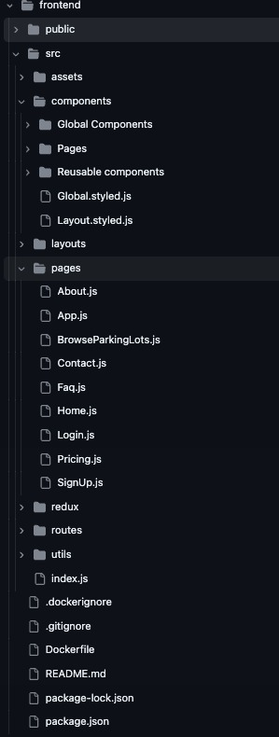
Repository Structure (Frontend)

Slide 8
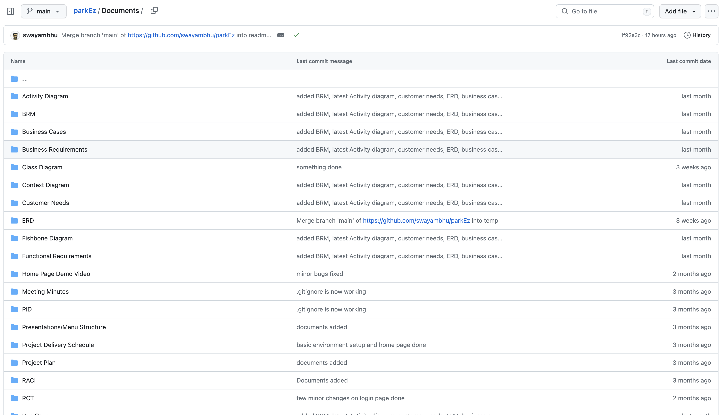
Repository Structure (Final Deliverables)

Slide 9
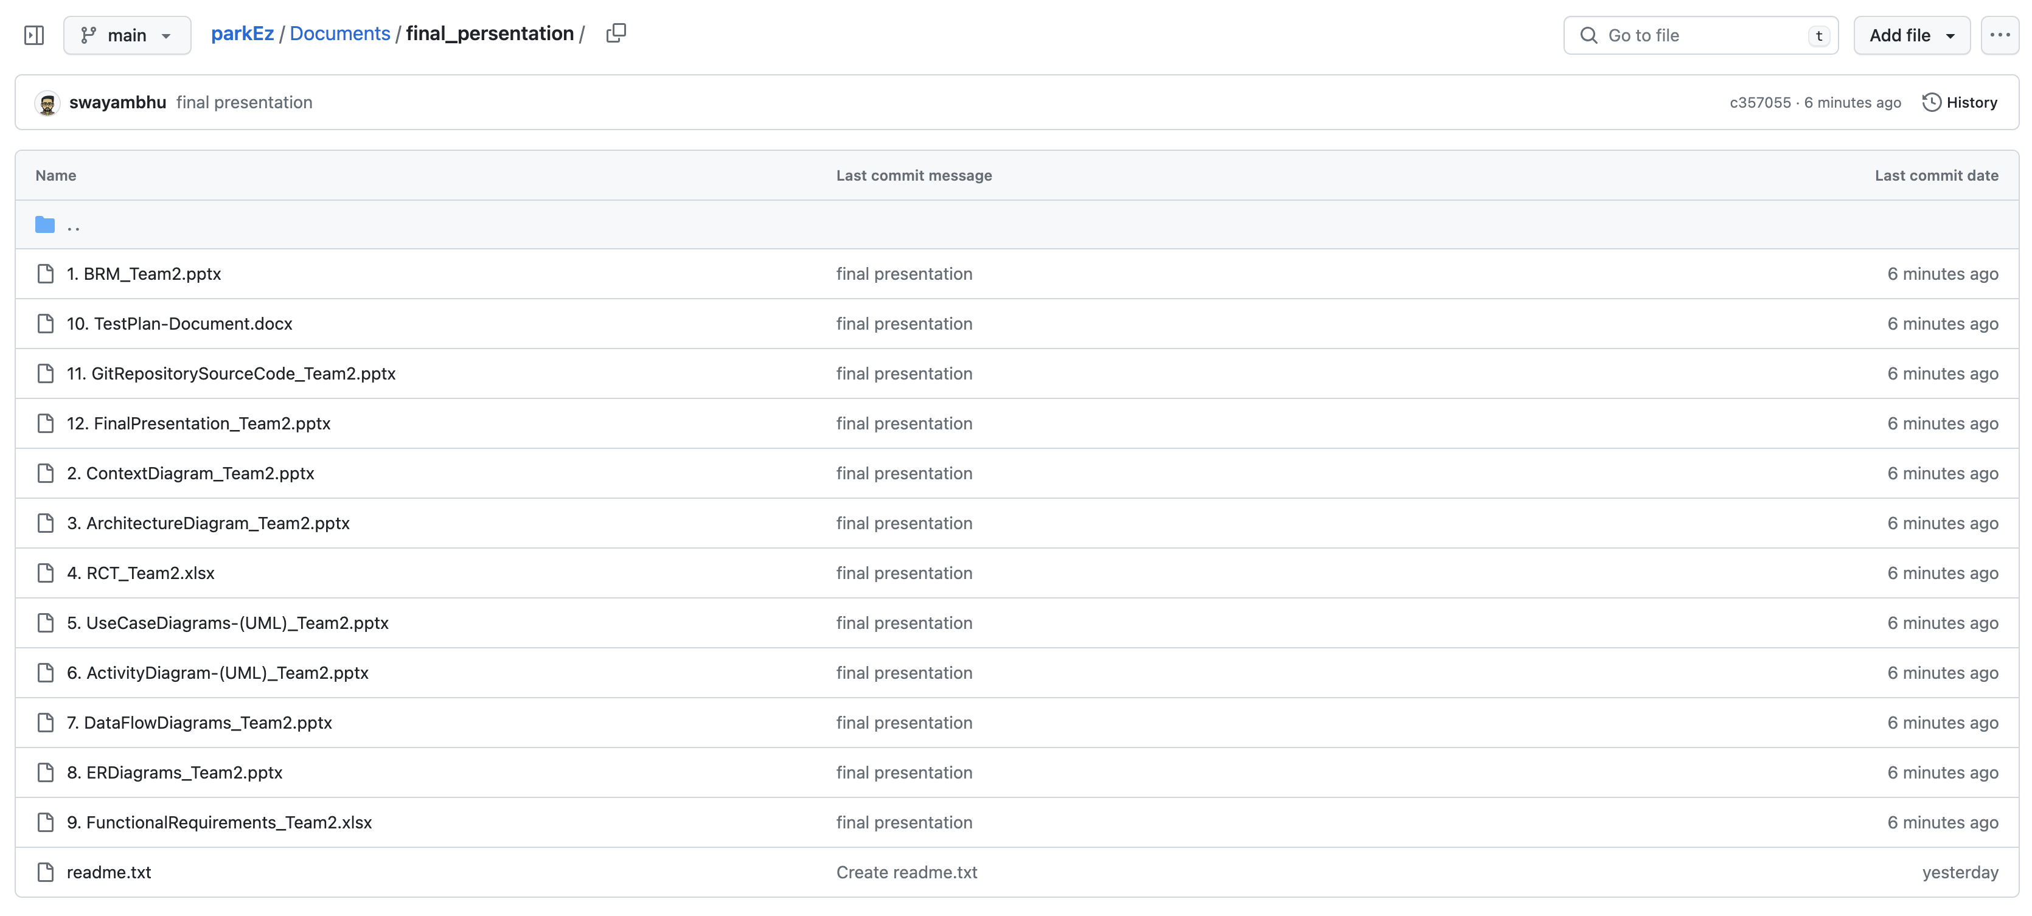
Repository Structure (Final Presentation)

Slide 10
03
Build & Deployment Procedures

Slide 11

Pre-requisites
Software Requirements:
1. Docker Desktop

Slide 12
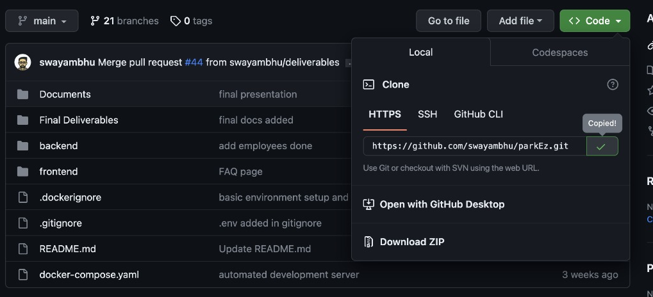
Installation Steps
Step 1 (Github Repo):-
1. Navigate to GitHub Repo(https://github.com/swayambhu/parkEz)
2. Copy the GitHub Clone

Slide 13
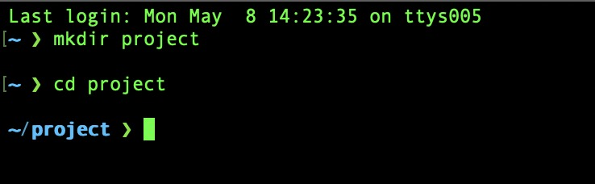
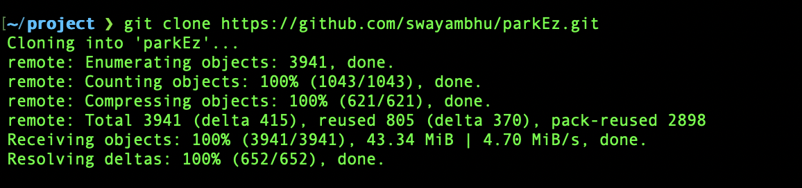
Installation Steps
Step 2 (Clone GitHub Repo):-
2.1 Navigate to the folder where you want to clone
2.2 Clone the repo using these commands
“git clone <repo_url>

Slide 14
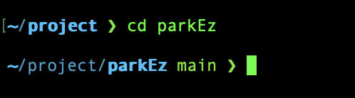

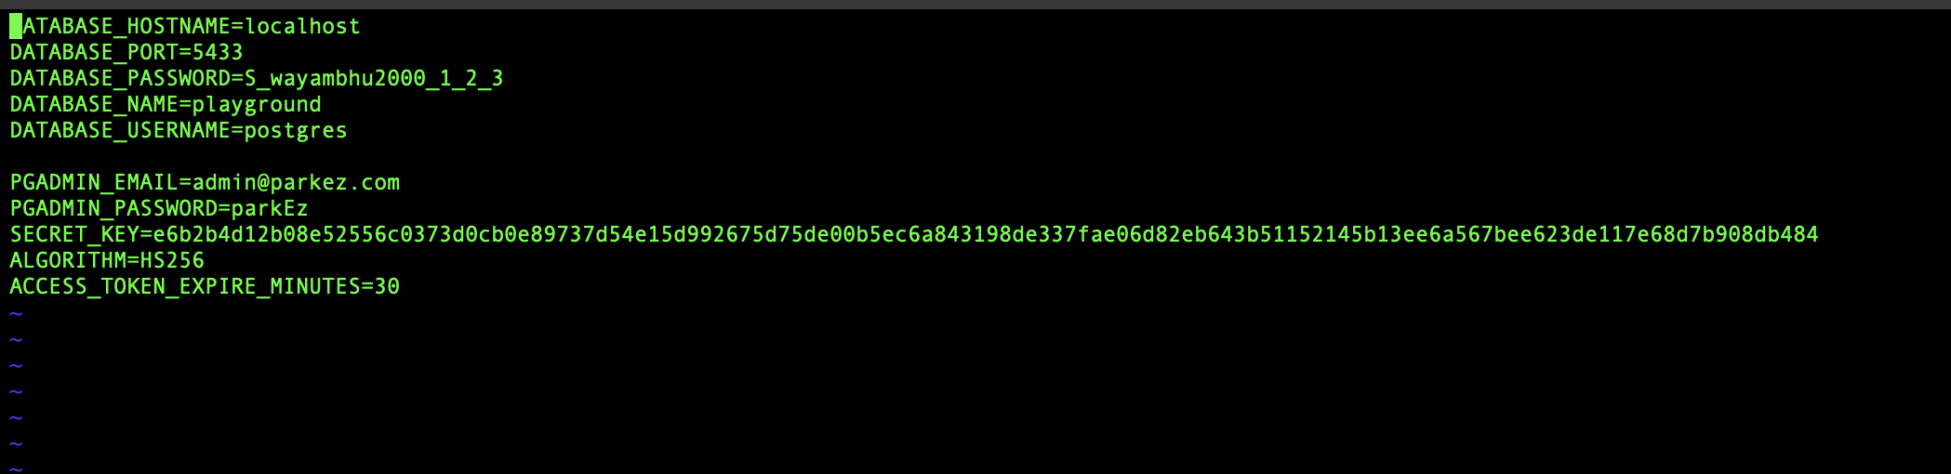
Installation Steps
Step 3 (Setting Up Environment Variables):-
3.1 Navigate to ParkEz Directory inside your folder
3.2 Create an .env file to store your environment variables.
The variables need are:

Slide 15
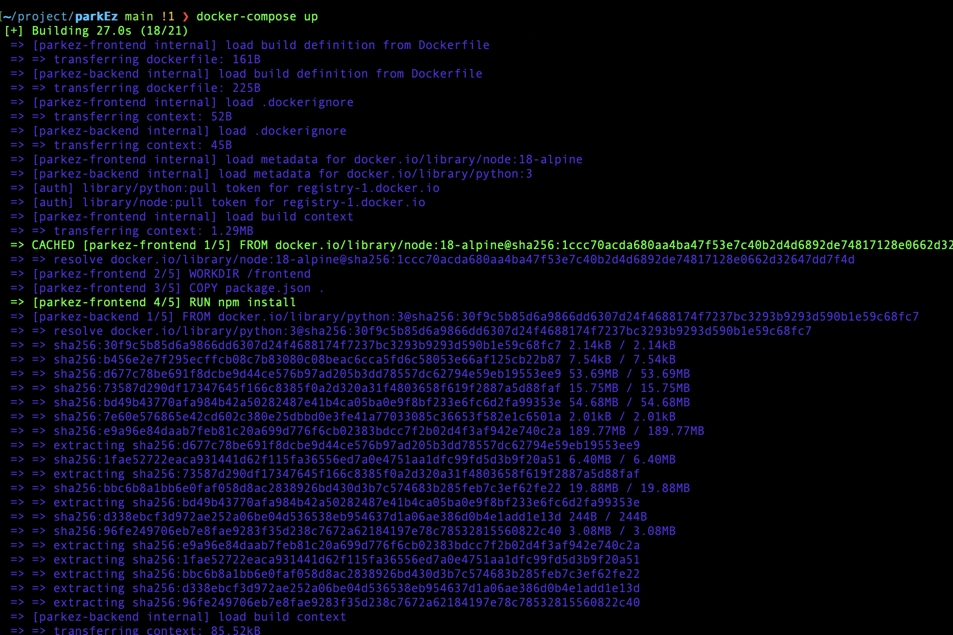
Installation Steps
Step 4 (Setting Up Development Environment):-
4.1 Start the Docker Desktop and run command
“docker-compose up” in you project/parkEz folder. And then the setup will be finished

Slide 16
04
Source Code Excerpt

Slide 17
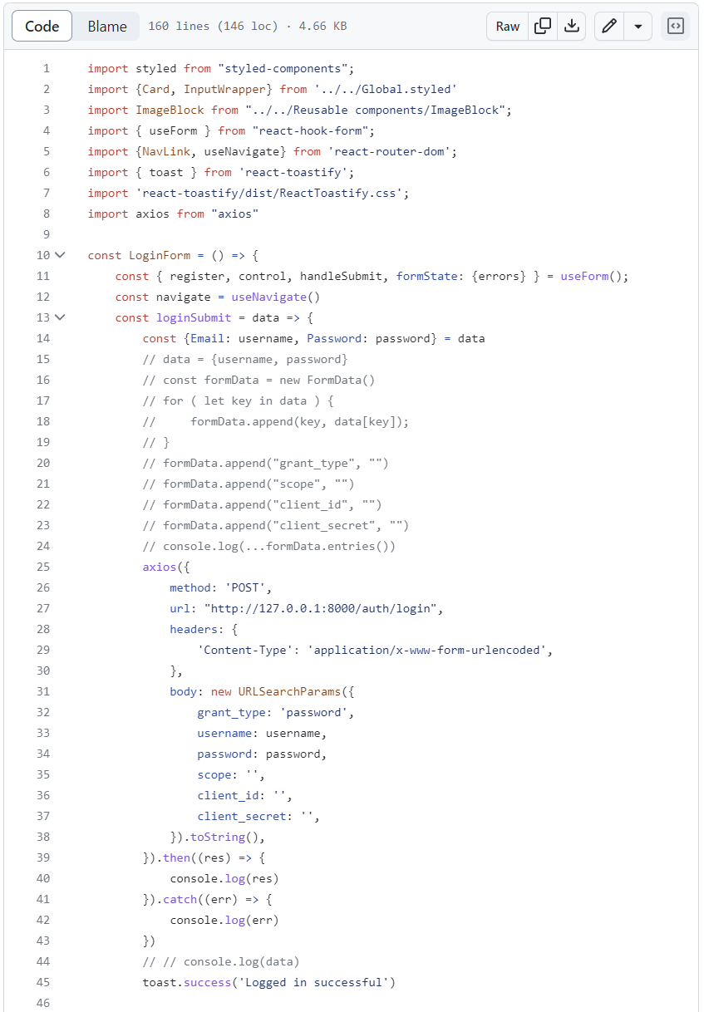
Feature-Log in

Slide 18
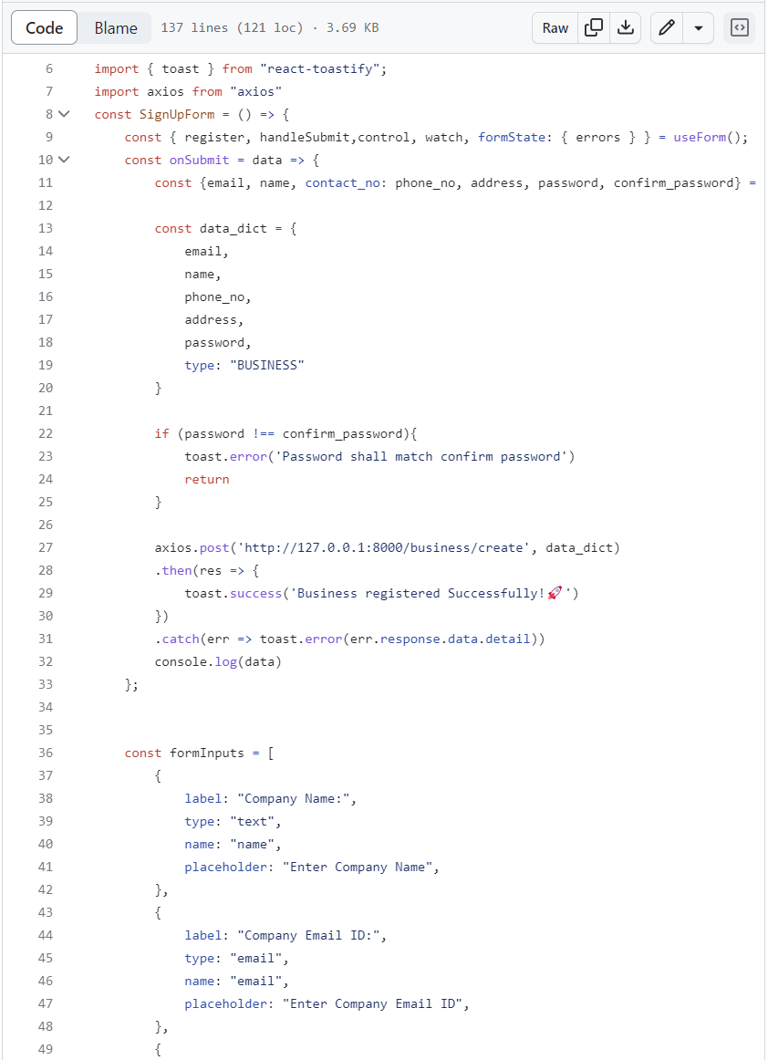
Feature- Sign up

Slide 19
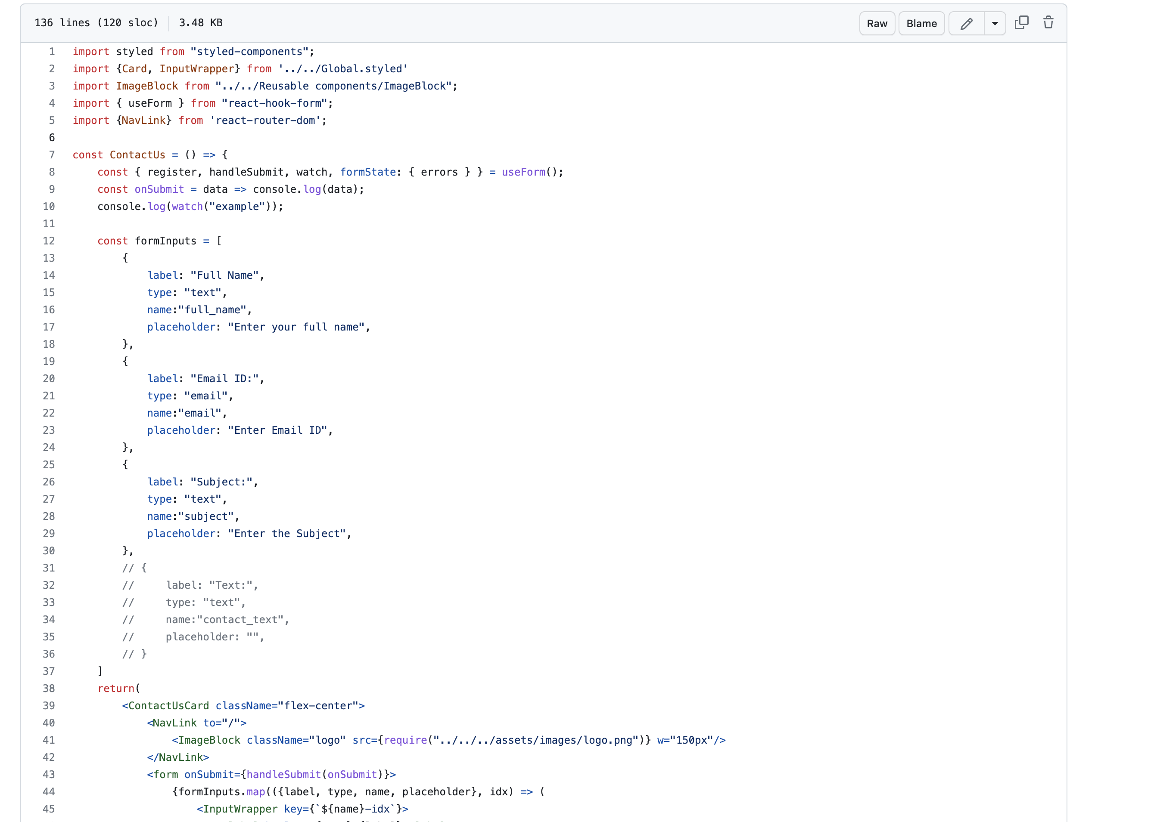
Feature- Contact us

Slide 20
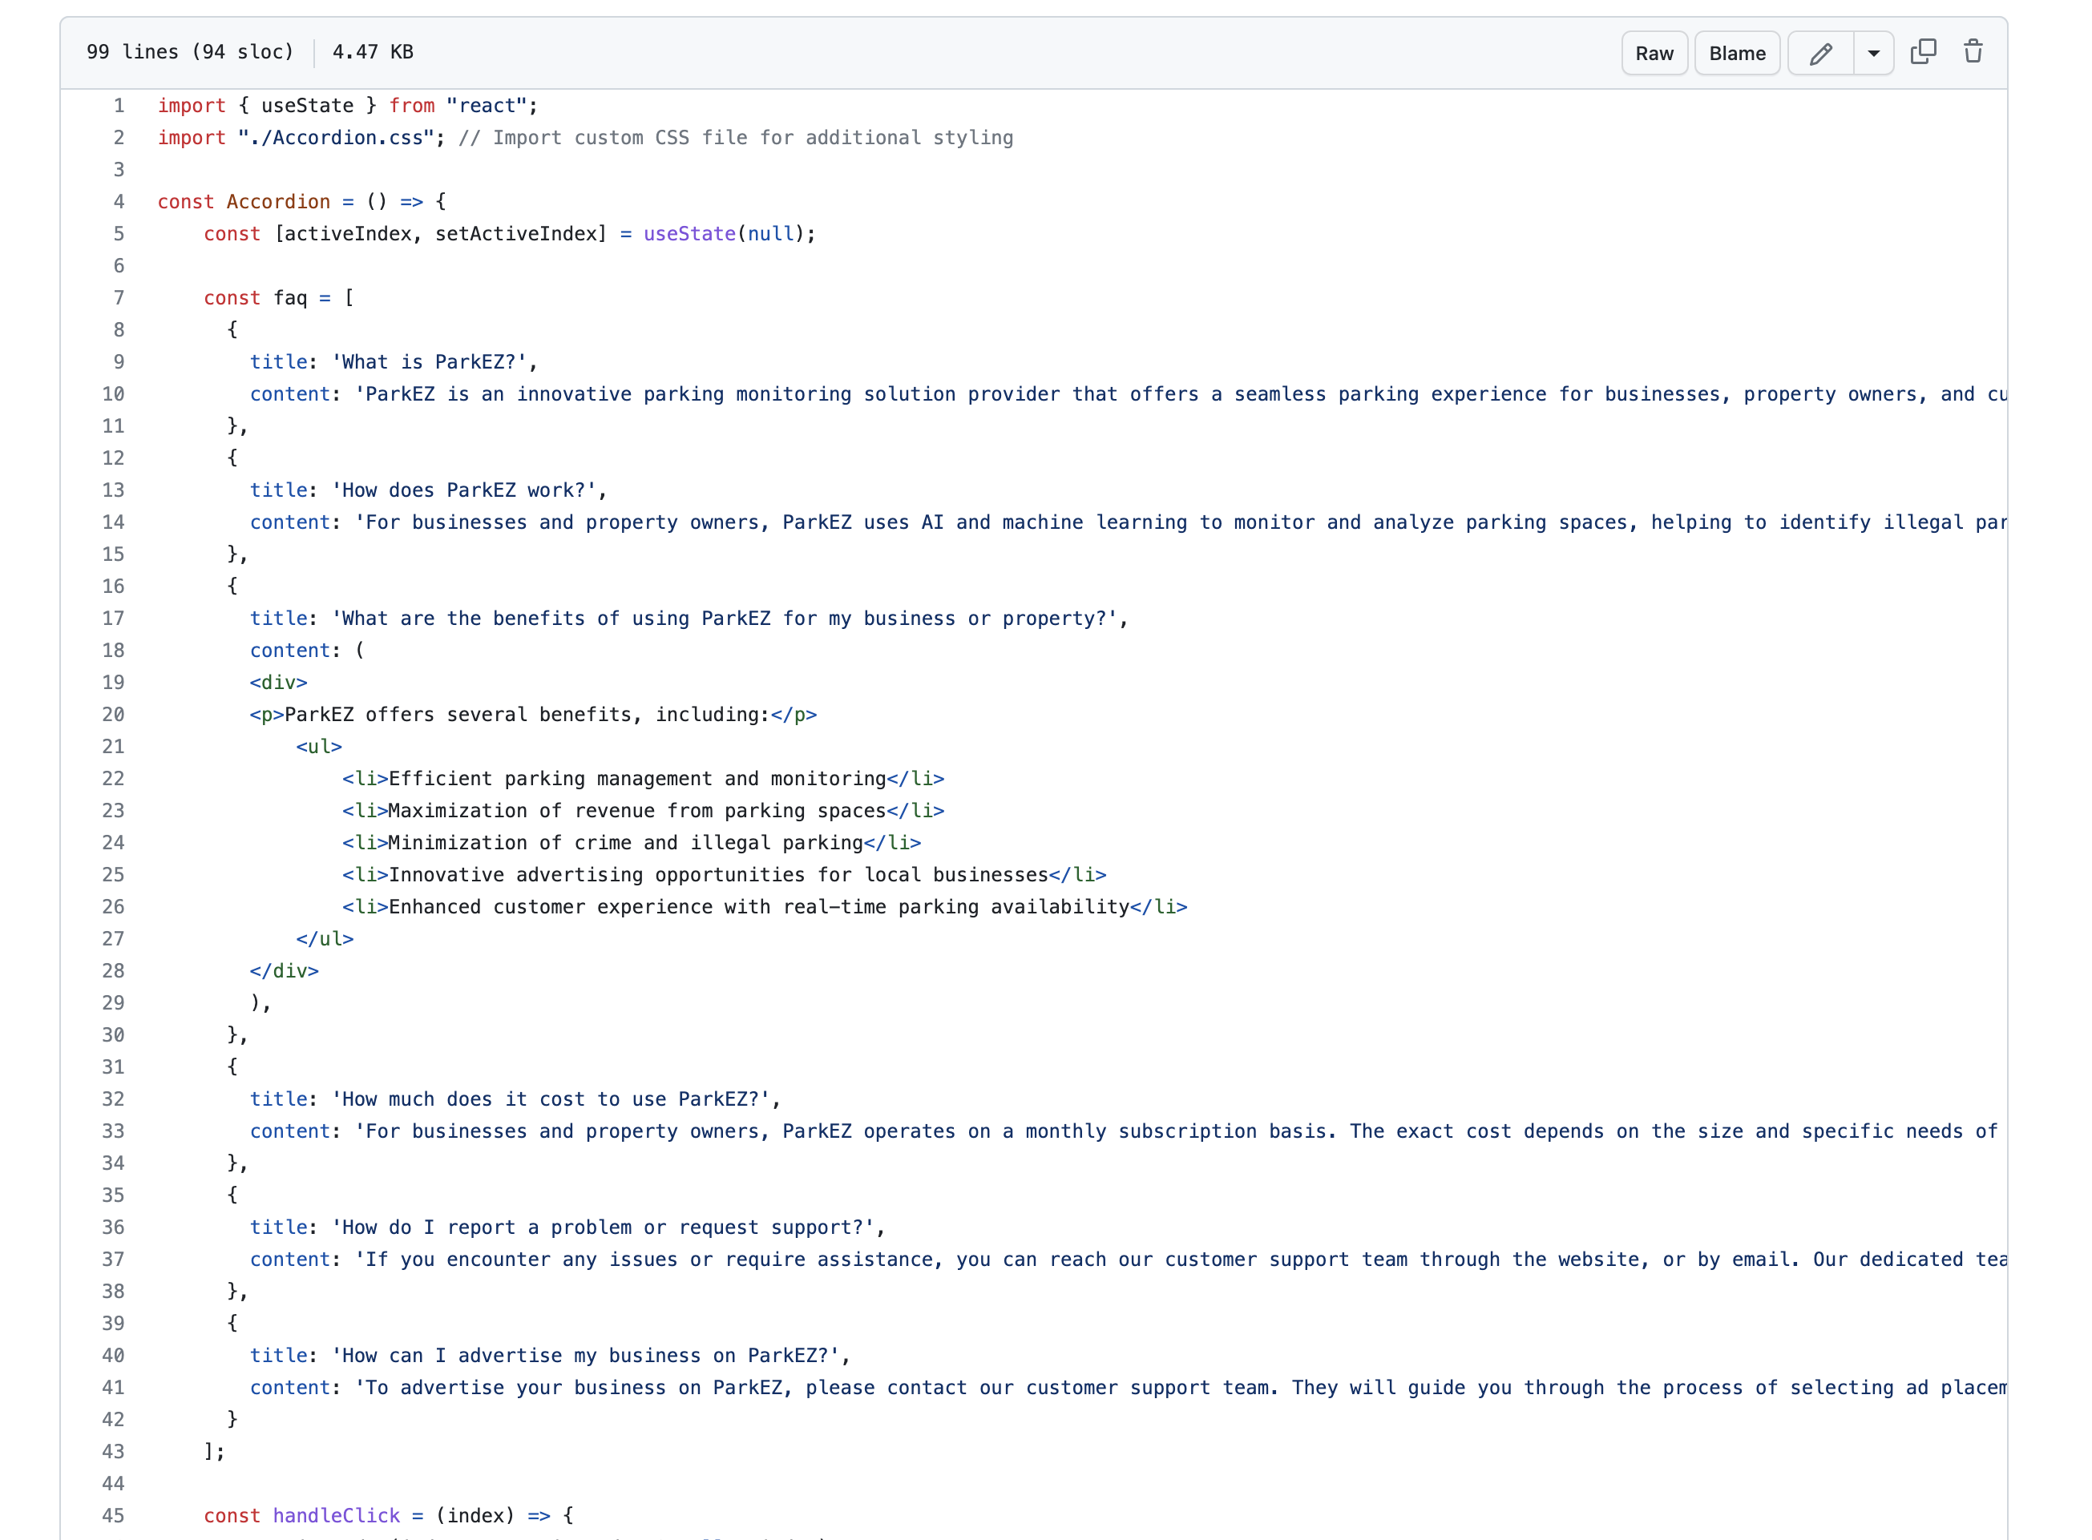
Feature- FAQ

Slide 21
Thank You!

